Slide 1
Functional Analysis in ESCs, iPSCs and Lineage-Specific Derivatives
Figures and Summary
- Arooja Tyagi and Ankur Monga

Slide 2
Contents
Table 1: Datasets
List of Common genes
In all datasets
Occurring in 6 out of 7 datasets
iPSCs vs ESCs
iPSCs derivatives
Intersection matrix of all 7 datasets
Reactome visualisation of pathways common in atleast 6/7 datasets at a time
STRING PPI with k-means clustering
Reactome visualisation of genes from iPSCs vs ESC comparative
Reactome visualisation of genes from iPSCs derivatives comparative
Enrichr cluster diagram
Prediction of gene interaction from geneMANIA
Venn diagram for DEGs in iPSCs vs ESC
Venn diagram for iPSC derivative

Slide 3
Dataset | Organism | Platform | Cell types | Comparisons
GSE38265 | Homo sapiens | Illumina HiSeq 2000 | Parent BJ cells, OSKM generated iPSCs, hESC | ESC Vs iPSCs
GSE69626 | Homo sapiens | Illumina HiSeq 2000 | hESCs control, hiPSCs control and generated hiPSCs | ESCs vs generated iPSCs
GSE239446 | Homo sapiens | Illumina HiSeq 2500 | hiPSCs derived NSCs, hiPSCs, hfNSCs and all their SREBF1-KO clones | hfNSCs vs hiPSCs
GSE164425 | Homo sapiens | Illumina HiSeq 3000 | HSC derived NK cells, CD8+ T cells, natural NK cells | HSC derived NK cells vs NK cells
GSE113253 | Homo sapiens | Illumina HiSeq 1500 | MSCs, osteoblasts, adipocytes | MSC vs osteoblasts MSC vs adipocytes
GSE252276 | Homo sapiens | Illumina HiSeq 1500 | RPE cell controls, AIPL1co, AIPL1wt | AIPLco vs control,
GSE139273 | Homo sapiens | Illumina HiSeq 3000 | iPSCs, iSNs, hDRGs | iPSCs vs iSNs iSNs vs hDRGs
Table 1: Datasets used for the Study
Table 1: Datasets chosen with their details given. Datasets were chosen for apt differential expression analysis and comparison based on epigenetic transition of the cell type and for their safety profiles for therapeutic applications.

Slide 4
Genes occurring in 6/7 datasets
ARSB
BAZ2B
BEX2
CAMK2N1
CERS6
COPZ2
CRISPLD2
CSF1
DDR2
DTNBP1
EMP1
ENC1
EPG5
EPHA4
FGD4
FILIP1L
FOXP1
FRMD4B
GBP3
GCNT1
GEM
GSAP
IFNGR1
IRS2
ITGB3BP
LPP
METAP2
NEAT1
NEK7
NFIX
NIPAL2
NR3C1
PFKFB3
PKIA
PLEKHA7
PRICKLE2
RAPH1
RPLP2
RRAGA
SFT2D2
SHPRH
SMCO4
SNN
SNX10
SNX30
SORT1
SOX13
SV2A
SYTL3
TBC1D2B
THBS1
TNRC6B
TRNT1
USP53
UTRN
XPO1
ZBTB37
ZEB1
ZNF268
Genes occurring in all datasets
TGIF1

Slide 5
Genes common in iPSCs vs ESC datasets
PPP1R12B
KCNJ13
SMAD2
KCNQ1OT1
RBPMS
GPC6
MBOAT1
ZNF488
LRRC2
SMCO4
ZBED3
TNFSF4
EXPH5
PHACTR1
DNAH9
MAK
PART1
SYT10
GAB1
CCND2
UTRN
ZNF875

Slide 6
Genes common in iPSCs derivatives datasets
ADORA2B
AHDC1
APBB2
APOOL
ARL4C
ARMC8
ATP6V1A
BCL2L1
BIRC3
CAMK2N1
CASP3
CDK17
CERS6
CFLAR
COMMD7
CPNE7
CRISPLD2
CSF1
DDIT4L
DUSP10
EHHADH
GK5
GSAP
HMOX1
HPS5
IFNGR1
IRS2
KCTD2
LRRC8A
MAP1A
MBOAT2
MGLL
MIB1
MTHFD2
MYC
NEK7
NIPAL2
NR3C1
NUDT6
PER1
PHLDB2
PI4K2A
PIK3R1
ENC1
EPG5
EPHA
FGD4
FOXN2
FOXP1
FRMD4B
GAS1
GCNT1
GEM
PLEKHA7
RALA
RALGPS2
RPS6KA3
SEMA3A
SLC11A2
SLC7A11
SNX30
SORT1
SOX13
TAF4B
TCEAL4
TGIF1
TXNIP
UPP1
USP53
ZEB1

Slide 7
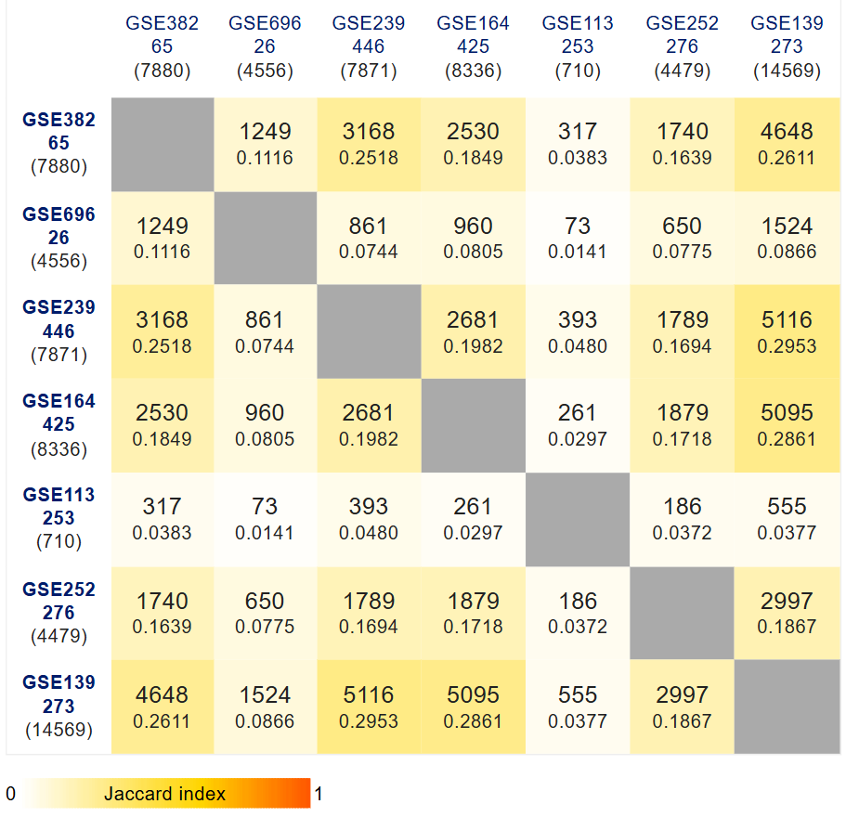
Fig 1: Intersection matrix of all 7 datasets depicting common genes and Jaccard Index.

Slide 8
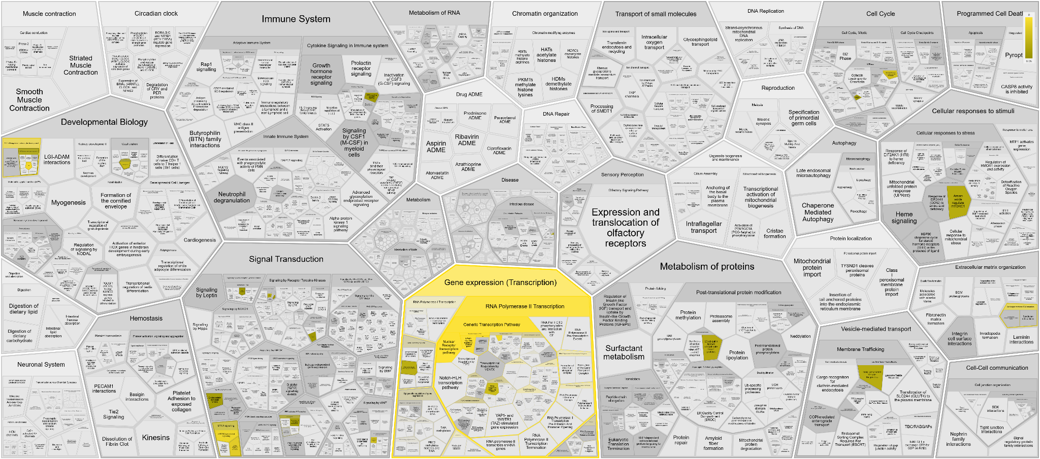
Fig 2: Reactome visualisation of pathways common in atleast 6/7 datasets at a time

Slide 9
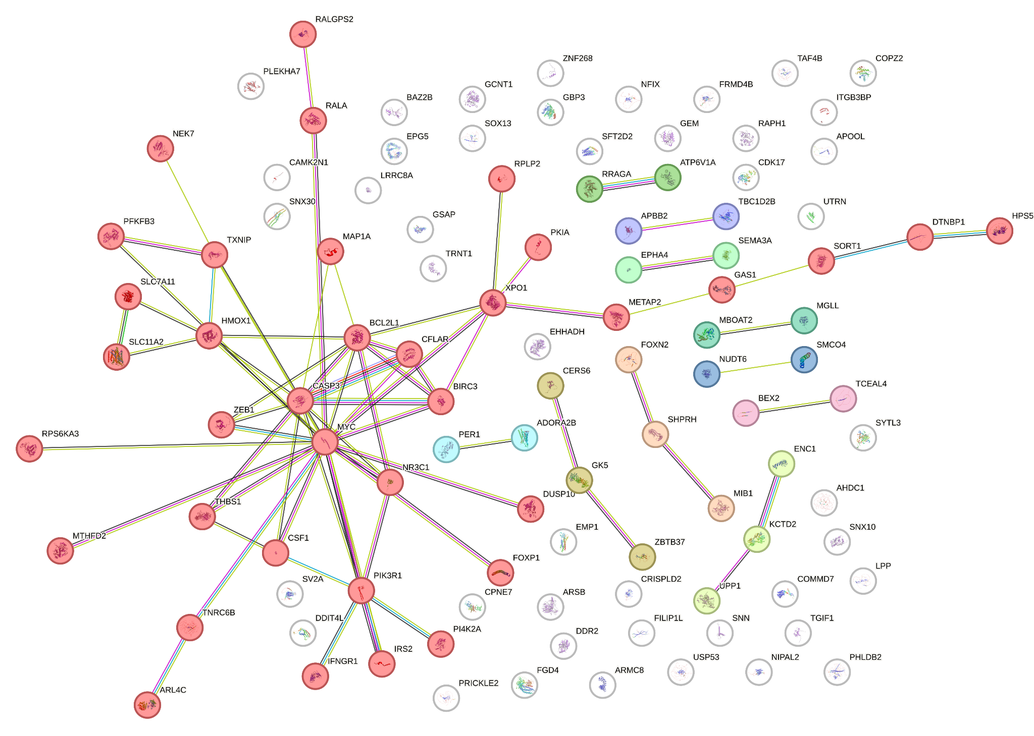
Fig 3: Genes with high occurrences and their interactions at protein level. Different colours depict different k-means clusters. Reg is cluster one.

Slide 10
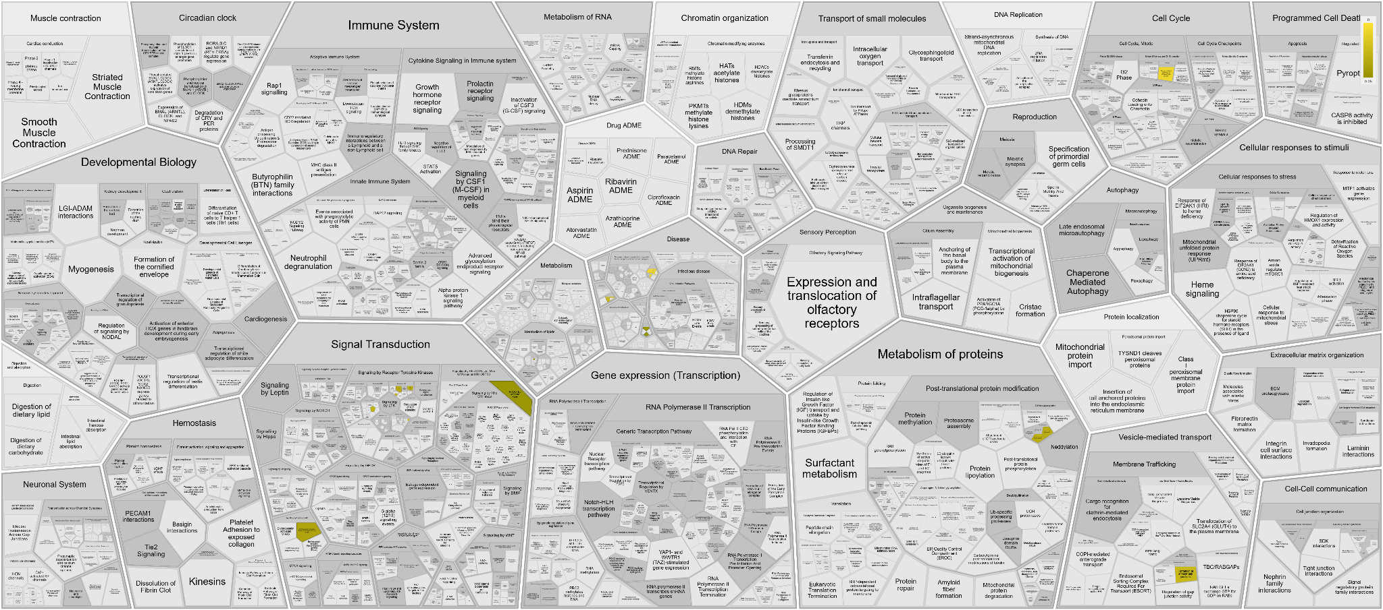
Fig 4: Reactome visualisation of genes from iPSCs vs ESC comparative

Slide 11
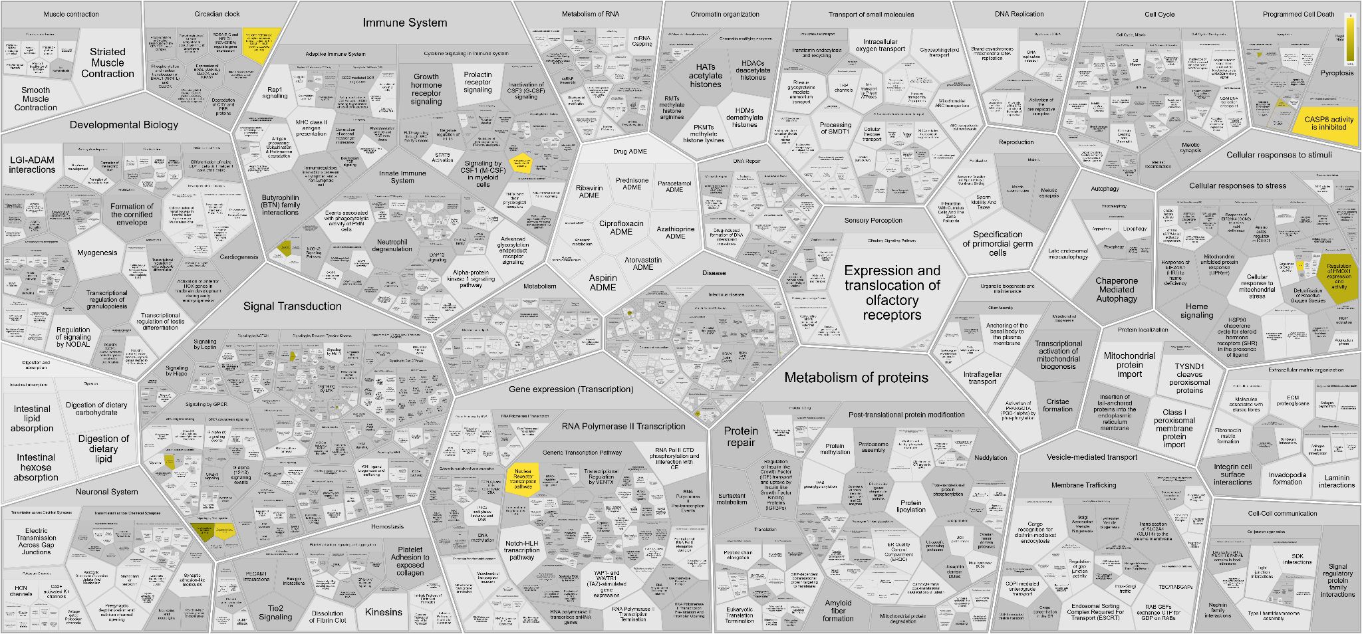
Fig 5: Reactome visualisation of genes from iPSCs derivatives comparative

Slide 12
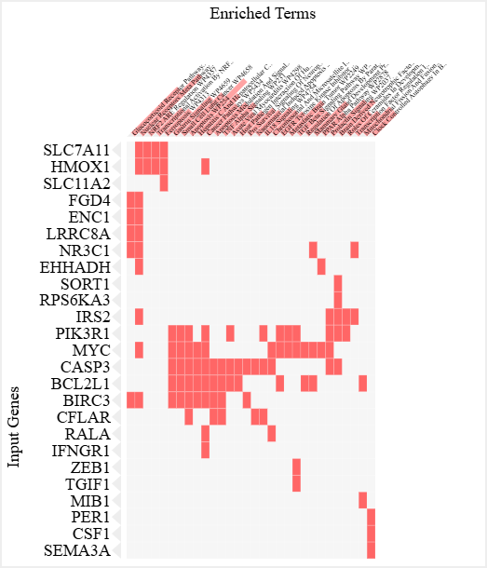
Fig 6: Enrichr cluster diagram showing genes and their correlated pathways.

Slide 13
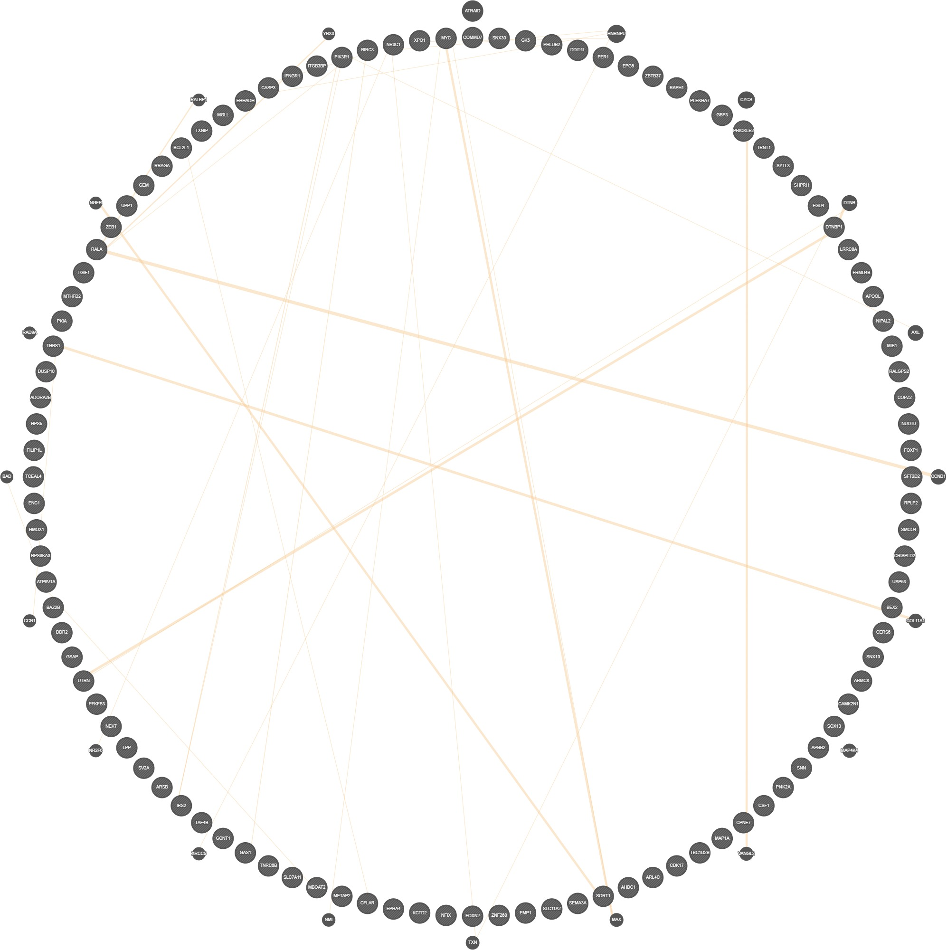
Fig 7: Prediction of gene interaction from geneMANIA on the common genes and interactors. HMOX1, TGIF1, AXL, FOXP1, NR2F2 and MAPK regulators are present which are responsible for inflammation management.

Slide 14
Other figures (not included in the current draft)

Slide 15
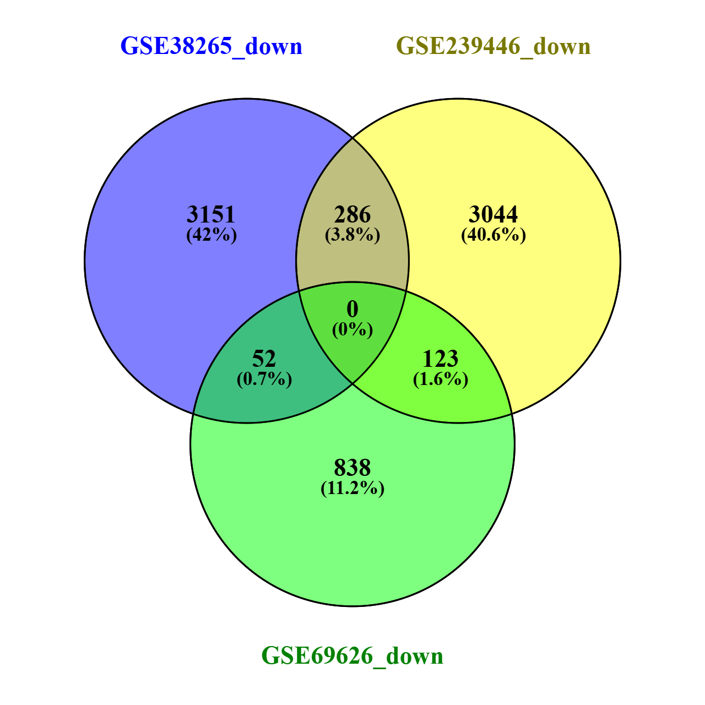
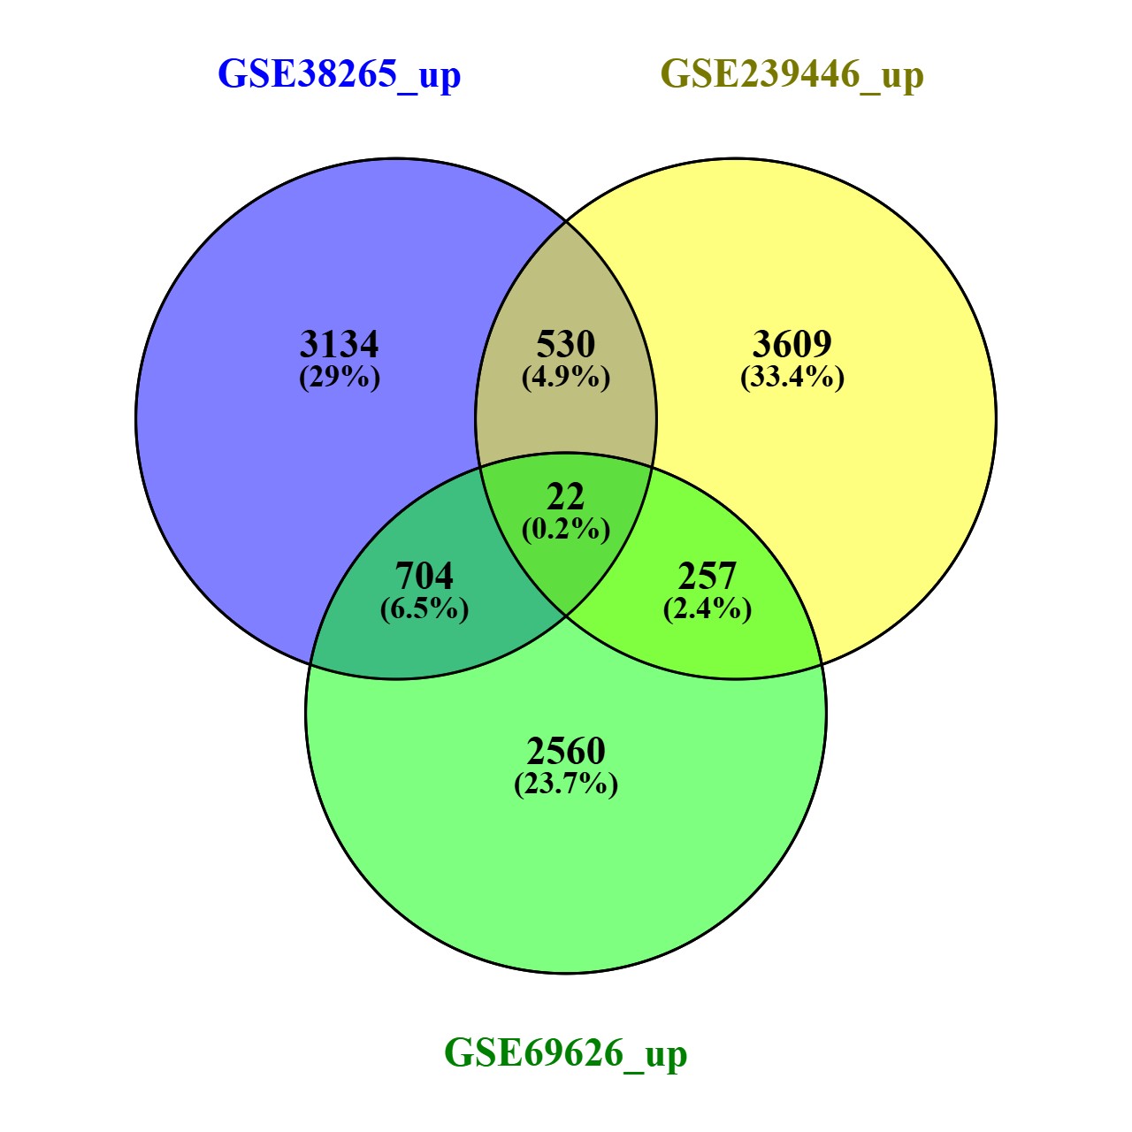
Figure: Venn diagram of common genes in iPSCs vs ESC comparative. NO common downregulated genes, 22 common upregulated genes

Slide 16
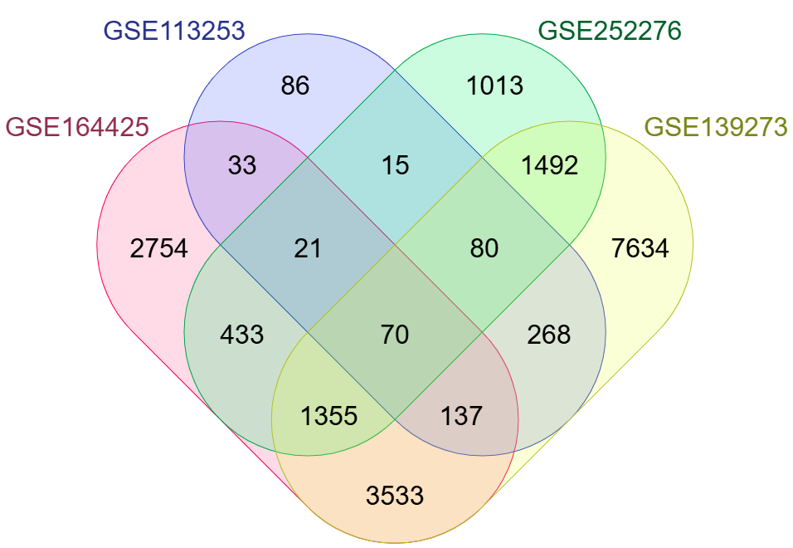
Fig: Venn diagram depicting common genes in iPSCs derivative comparatives

